Slide 1
TABleau

Slide 2
What is Tableau?
Tableau is a very powerful data visualization tool that can be used by data analysts, scientists, statisticians, etc. to visualize the data and get a clear opinion based on the data analysis
Tableau is very famous as it can take in data and produce the required data visualization output in a very short time. Basically, it can elevate your data into insights that can be used to drive your action in the future.
.In fact, it is a lifesaver for many people in Business Intelligence as it allows you to handle data without having great technical knowledge. So you can use Tableau as an individual data analyst or at a large scale for your business team and organization. In fact, there are many organizations using Tableau such as Amazon, Lenovo, Walmart, Accenture, etc.

Slide 3
Advantages of Tableau
1. Create great visualizations
Of course, the first advantage of a data visualization tool is that you can create wonderful and detailed data visualizations using data that initially wasn’t very ordered. You can use Tableau Prep to shape, clean, and combine the data into desired forms so that it can be used for creating data charts, dashboards, visualizations, etc.
2. Obtain detailed insights
You can obtain detailed and unexpected insights from the data using Tableau. You can explore the data from different angles to see if any patterns emerge or you can even ask open-ended questions from the data and perform various comparisons to obtain unexpected insights. This effect is heightened even more when you are using real-time data as it changes your viewpoint continuously.

Slide 4
3. Support for Different Data Sources
Tableau can connect to various data sources, data warehouses, and files that contain disparate data and exist in different kinds of storage mediums. Tableau can access data from the cloud, data that is available in spreadsheets, big data, non-relational data, etc. Tableau has the capacity to manage data from all these different data sources and blend these different types of data to create complex and detailed data visualizations that are an asset to IT companies.

Slide 5
Tableau Installation
Tableau is a free software that allows user to easily create amazing and interactive visualizations and that too without any programming. Using this tool, one can simplify raw data into a much understandable form. Being easy and powerful, Tableau is a very popular data visualization tool in the Business industry.
Prior knowledge to work on Tableau –
Basic Computer Knowledge: How to run a given program and interact with any computer application.
Experience with spreadsheet program
Open to experience and learning
Installation –
Go to the link – https://www.tableau.com
Go to the Products, there are four options
Tableau Desktop : It is a desktop software for individual use.
Tableau Prep : It has two products – Tableau Prep Builder and Tableau Prep Conductor to build the data flow and schedule, monitor and manage the work flows across the organization.
Tableau Server : It is more of an enterprise application.

Slide 6
Tableau Online : It is a public software so anything uploaded to it is available to others who are using this software. This means that your work is no more private and confidential.
Select Tableau Desktop > Try it for free.
Selected the software version as per your system requirement. Download your free trial software.
If you want to avoid trial then download Tableau Public

Slide 7
The Tableau Workspace/Interface
I.
The Tableau workspace consists of menus, a toolbar, the Data pane, cards and shelves, and one or more sheets. Sheets can be worksheets, dashboards, or stories. For details on dashboard or story workspaces, see Create a Dashboard or The Story Workspace.
A. Workbook name. A workbook contains sheets. A sheet can be a worksheet, a dashboard, or a story. For more information, see Workbooks and Sheets.
B. Cards and shelves - Drag fields to the cards and shelves in the workspace to add data to your view.
C. Toolbar - Use the toolbar to access commands and analysis and navigation tools.
D. View - This is the canvas in the workspace where you create a visualization (also referred to as a "viz").
E. Click this icon to go to the Start page, where you can connect to data. For more information, see Start Page.

Slide 8
F. Side Bar - In a worksheet, the side bar area contains the Data pane and the Analytics pane
G. Click this tab to go to the Data Source page and view your data. For more information, see Data Source Page.
H. Status bar - Displays information about the current view.
I. Sheet tabs - Tabs represent each sheet in your workbook. This can include worksheets, dashboards, and stories.

Slide 9
Connecting Data
Tableau can connect to all the popular data sources which are widely used. Tableau’s native connectors can connect to the following types of data sources.
File Systems such as CSV, Excel, etc.
Relational Systems such as Oracle, Sql Server, DB2, etc.
Cloud Systems such as Windows Azure, Google BigQuery, etc.
Other Sources using ODBC
The following picture shows most of the data sources available through Tableau’s native data connectors.

Slide 10
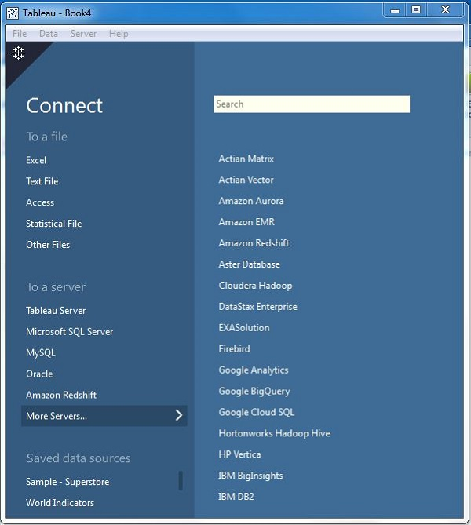

Slide 11
What is ODBC?
Open Database Connectivity (ODBC) is an open standard Application Programming Interface (API) for accessing a database.
Connect Live
The Connect Live feature is used for real-time data analysis. In this case, Tableau connects to real-time data source and keeps reading the data. Thus, the result of the analysis is up to the second, and the latest changes are reflected in the result.

Slide 12
Join Your Data
Relationships vs Joins
The default method in Tableau Desktop is to use relationships. Relationships preserve the original tables’ level of detail when combining information. Relationships also allow for context-based joins to be performed on a sheet-by-sheet basis, making each data source more flexible. Relationships are the recommended method of combining data in most instances. For more information, see How Relationships Differ from Joins.
However, there may be times when you want to directly establish a join, either for control or for desired aspects of a join compared to a relationship, such as deliberate filtering or duplication.
Common issues
To view, edit, or create joins, you must open a logical table in the relationship canvas—the area you see when you first open or create a data source—and access the join canvas.
Published Tableau data sources cannot be used in joins. To combine published data sources, you must edit the original data sources to natively contain the join or use a data blend.
When joining tables, the fields that you join on must be the same data type. If you change the data type after you join the tables, the join will break.
Fields used in the join clause cannot be removed without breaking the join. To join data and be able to clean up duplicate fields, use Tableau Prep Builder instead of Desktop

Slide 13
Create a join
To create a join, connect to the relevant data source or sources.
These can be in the same data source (such as tables in a database or sheets in an Excel spreadsheet) or different data sources (this is known as a cross-database join). If you combined tables using a cross-database join, Tableau colors the tables in the canvas and the columns in the data grid to show you which connection the data comes from.
Drag the first table to the canvas.
Select Open from the menu or double-click the first table to open the join canvas (physical layer).
Double-click or drag another table to the join canvas.
Click the join icon to configure the join. Add one or more join clauses by selecting a field from one of the available tables used in the data source, choosing a join operator, and a field from the added table.
When finished, close the join dialog and join canvas

Slide 14
Join types
Join Type | Result
Inner | When you use an inner join to combine tables, the result is a table that contains values that have matches in both tables. When a value doesn't match across both tables, it is dropped entirely.
Left | When you use a left join to combine tables, the result is a table that contains all values from the left table and corresponding matches from the right table. When a value in the left table doesn't have a corresponding match in the right table, you see a null value in the data grid.
Right | When you use a right join to combine tables, the result is a table that contains all values from the right table and corresponding matches from the left table. When a value in the right table doesn't have a corresponding match in the left table, you see a null value in the data grid.
Full outer | When you use a full outer join to combine tables, the result is a table that contains all values from both tables. When a value from either table doesn't have a match with the other table, you see a null value in the data grid.
Union | Though union is not a type of join, union is another method for combining two or more tables by appending rows of data from one table to another. Ideally, the tables that you union have the same number of fields, and those fields have matching names and data types. For more information about union, see Union Your Data.

Slide 15
Tableau – Data Types
Tableau is the easy-to-use Business Intelligence tool used in data visualization. Its unique feature is, to allow data real-time collaboration and data blending, etc. Through Tableau, users can connect databases, files, and other big data sources and can create a shareable dashboard through them. Tableau is mainly used by researchers, professionals, and government organizations for data analysis and visualization.
The data type classifies the data value into its definite type, some may be characters (eg- ‘Vansh’), some may be integers (eg- 108), and some may be floating type (eg- 1.854), etc. In this way, every data value lies under certain data types. Tableau too has a set of data types under which it classifies data value present in it as field values.
In Tableau, we have seven primary data types. The function of Tableau is to automatically detect the data types of various fields, as soon as the data is uploaded from the source and allocate it to the fields. These seven data types are:

Slide 16
String values
Number/Integer values
Date values
Date & Time values
Boolean values
Geographic values
Cluster or mixed values
1.String Data type: The collection of characters give rise to the string data type. A string is always enclosed within a single or double inverted comma. The samples of the string are — “Vansh”, “Hi! How are you?”, and “GeeksforGeeks”, etc.
We can divide String data type into two types, Char and Varchar.

Slide 17
Char string type- Char data type normally stores alphanumeric data values having fixed lengths. If the user enters a string value which is greater than the fixed length of the Char data type, then the system returns an error.
Varchar string type- Varchar data type also stores alphanumeric data values. As the name suggests, Varchar stores data values having a variable length. So, the user can enter as many string values as they want, without facing any restriction from the system.
2.Numeric Data type: This data type consists of both integer type or floating type. Out of which users prefer to use integer type over floating type, as it is difficult to accumulate the decimal point after a certain limit. It also contains a function known as the Round() function which can be used in rounding up float values.
3.Date and Time Data type: Tableau supports all forms of date and time like dd-mm-yy, or mm-dd-yyyy, etc. And the time data values can be in the form of a decade, year, quarter, month, hour, minutes, seconds, etc. Whenever the user enters data and time values, Tableau automatically registers it under Date data type and Date & Time data value.
4.Boolean Data type: As a result of relational calculations, Boolean data type values are formed. The boolean data values are either True or False. Many a time the result of a relational calculation is unknown, in this situation Null data values are used.

Slide 18
5.Geographic Data type: All values that are used in maps, comes under geographic data type. The example of geographic data values is country name, state name, city, region, postal codes, etc.
6.Cluster or Mixed Data type: Sometimes data set contains values having a mixture of data types. Such values are known as cluster group values or mixed data values. In such a situation, users have the option either to handle it manually or allow Tableau to operate on it.

Slide 19
Dimensions and Measures in Tableau
What are Dimensions in Tableau?
A dimension is a field that can be considered an independent variable. Dimensions in Tableau produce headers when added to the Rows or Columns shelves in the view. By default, Tableau treats any field containing qualitative, categorical information as a dimension. However, in relational data sources, the actual definition of a Dimension is slightly more complex.
What are Measures in Tableau?
A measure is a field that is a dependent variable; that is, its value is a function of one or more dimensions. Measures typically produce axes when added to the rows or columns shelves. By default, Tableau treats any field containing numeric (quantitative) information as a measure.

Slide 20
Dimensions Vs Measures in Tableau
A measure can be aggregated for each value of the dimension. For example, if we want to calculate the Sum of “Sales” for every “State in India”. In this scenario, the State field is acting as a Dimension because you want to aggregate sales for each state. The values of Sales fields (Measures) are dependent on the State, So State is an independent field and Sales is a dependent field.
The values of Sales fields (Measures) are dependent on the State filed. This means that a measure is a function of other dimensions placed on the worksheet. In this case, the Sales field is acting as a measure because you want to aggregate the field for each state. But measures could also result in a non-numeric result.
Discrete Vs continuous
In Tableau, all relational fields containing numbers are treated as measures. However, you might decide that some of these fields should be treated as dimensions. In addition to dimensions and measures, each field in Tableau is categorized as either discrete or continuous. When a field is discrete it is shown in Blue color and when a field is continuous it is shown in Green color.

Slide 21
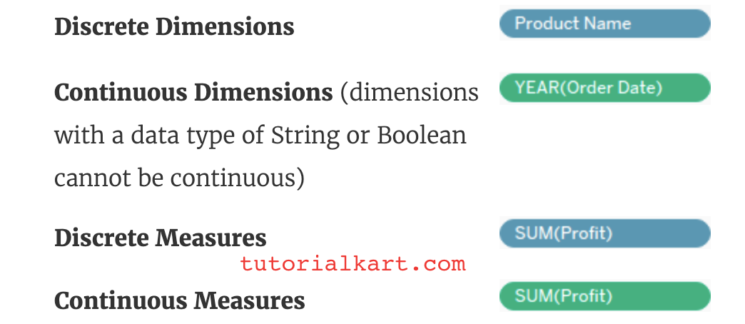

Slide 22
Show Me in Tableau
Show Me: Show Me window holds the most commonly used charts in Tableau. You can use any of these charts to view the data. Click Show Me on the toolbar to open this window, as we have shown below.
Steps to generate various illustrations from Show Me window in Tableau:
Open Tableau tool and click on Show start Page.

Slide 23
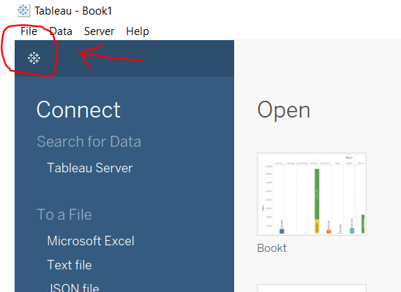

Slide 24
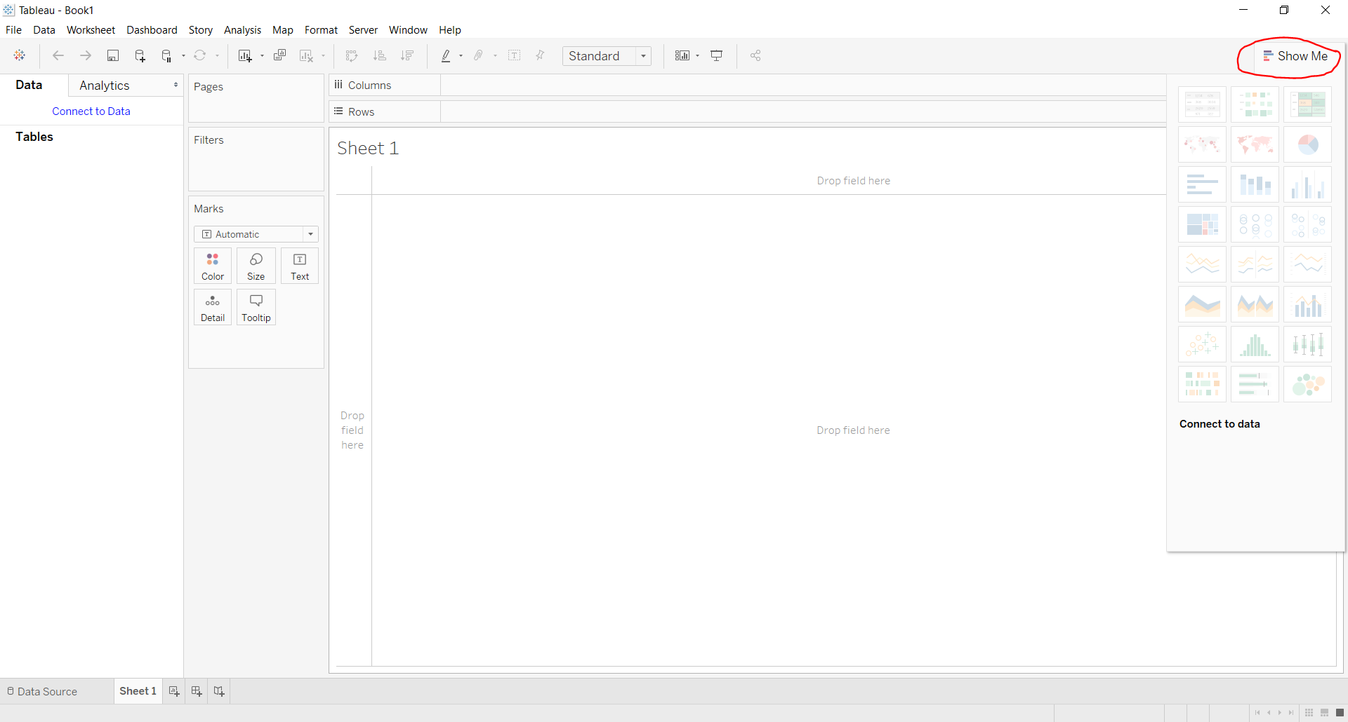

Slide 25
Text Label | Symbol Maps | Horizontal Bars | Tree Map
Heat Map | Maps | Stacked Bars | Circle Views
Highlight Table | Pie Charts | Side-by-Side Bars | Side-by-Side Circle Views
Line Chart | Discrete Lines | Dual Lines | Area Chart
Discrete Area Chart | Dual Combination Chart | Scatter Plot | Histograms
Box and Whisker Plots | Gantt Chart | Bullet Graph | Packed Bubbles Chart

Slide 26
Filters
In Tableau Desktop, open the workbook, or create a new one, and set up the connection to the data you want to filter.
Navigate to the worksheet that you want to apply a filter to.
Select Server > Create User Filter. Then select the field you want to use for filtering the view. This example uses Region.
If prompted, sign in to your server or site. For information, see Sign in to Tableau Server or Tableau Online.
In the User Filter dialog box, type a name for the set of rules you are creating.
In this example, we’ll use Regional Managers.
In the list on the left, select a user or group. On the right, select the individual members of the field you selected earlier, that you want the selected users to be able to see.
For this example, selected user Andrew Allen is the manager of the Eastern region, so in the field member list, you would select East.

Slide 27
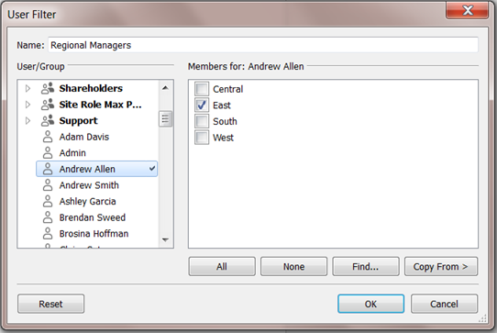

Slide 28
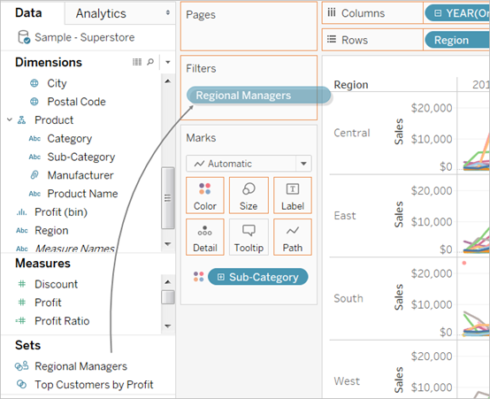
Repeat this process for each user or group, and click OK when you’re done mapping users to values.
After you create the user filter, it appears in the Sets area of the Data pane.
Drag the user filter to the Filters shelf.

Slide 29
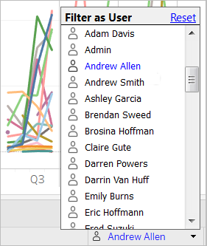
The filter becomes a context filter, and the view adjusts to show data that you are allowed to see.
Do any of the following to test or fine-tune the filter:
If the view appears as a blank canvas, you need to allow yourself or a group you are a member of to see a region.
In the Sets area of the Data pane, open the drop-down menu on the user filter, and then select Edit Set.
To preview how the filter works in the published view, in the lower-right corner of the workbook, open the Filter as User menu, and select the user or group from the list.

Slide 30
To return to viewing the workbook as yourself, in the top right corner of the Filter as User menu, select Reset.
To copy the mapping selections you set on one user or group to another (rather than manually mapping the same settings)

Slide 31
Connect to the data and set up the user filter
In Tableau Desktop, open the workbook you want to add user filtering to, or create a new one, connecting to the data you want to filter.
In this example, we use a table called Orders.
On the Data Source page, add the reference table, creating a left join. Here we add the People table and create a left join on the Region field.
Go to the worksheet, select Analysis > Create Calculated Field, and create the following field:
Name: User is a manager
Formula: USERNAME() = [Manager]

Slide 32
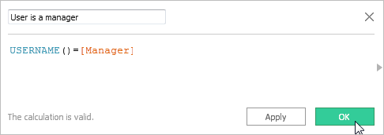
This new true/false field appears in the Dimensions pane. The formula returns TRUE if the user name of the person signed in to the server exists in the manager column.
Add the User is a manager field to the Filters shelf.
In the Filter dialog box, select True, and then click OK.
This sets the filter so that only people who are managers can see the data in the view.
If you are not listed in the Manager field, your view might appear as a blank canvas.
See how the view looks to a particular person: in the lower-right, open the Filter as User menu, and select someone you know is a manager.
The following image shows how the view shown earlier would look if Andrew Allen were signed in.

Slide 33
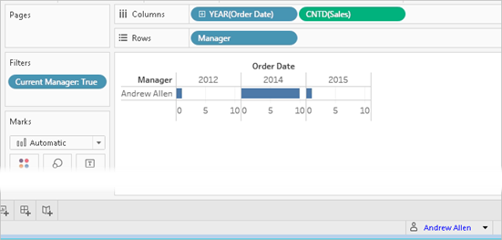

Slide 34
GROUP
Create a group
There are multiple ways to create a group. You can create a group from a field in the Data pane, or by selecting data in the view and then clicking the group icon.
Create a group by selecting data in the view
In the view, select one or more data points and then, on the tooltip that appears, click the group icon .
Note: You can also select the group icon on the toolbar at the top of the workspace.
If there are multiple levels of detail in the view, you must select a level to group the members. You can select to group all dimensions, or just one.
Create a group from a field in the Data pane
In the Data pane, right-click a field and select Create > Group.

Slide 35
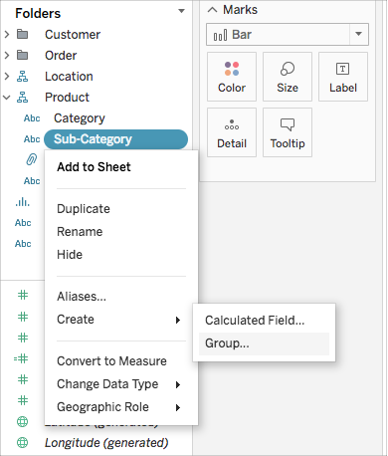

Slide 36
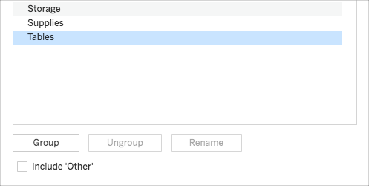
In the Create Group dialog box, select several members that you want to group, and then click Group.

Slide 37
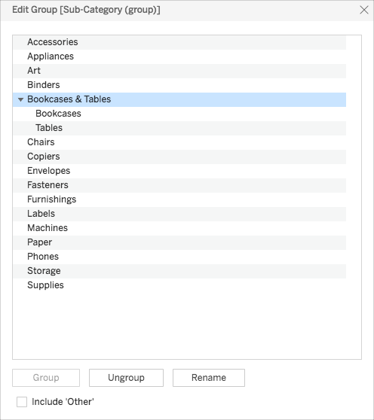
The selected members are combined into a single group. A default name is created using the combined member names.
To rename the group, select it in the list and click Rename.
Tip: You can search for members using the Find option near the bottom-right of the dialog box. (Tableau Desktop only)

Slide 38
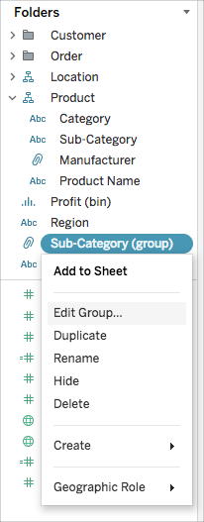
Edit a Group
After you have created a grouped field, you can add and remove members from the groups, create new groups, change the default group names, and change the name of the grouped field. You can make some changes directly in the view, and others through the Edit Group dialog box.
To add members to an existing group:
In the Data pane, right-click the group field, and then click Edit Group.

Slide 39
In the Edit Group dialog box, select one or more members and drag them into the group you want.
Click OK.
To remove members from an existing group:
In the Data pane, right-click the group field, and then click Edit Group.
In the Edit Group dialog box, select one or more members, and then click Ungroup.
The members are removed from the current group. If you have an Other group, the members are added to it.
Click OK.
To create a new group in a group field:
In the Data pane, right-click the group field, and then click Edit Group.
In the Edit Group dialog box, select one or more members, and then click Group.
Click OK.
Note: To rename a group, select the group in the Edit Group dialog box, and then click Rename.

Slide 40
Create an aggregate calculation Follow along with the steps below to learn how to create an aggregate calculation. In Tableau Desktop, connect to the Sample - Superstore saved data source, which comes with Tableau. Navigate to a worksheet and select Analysis > Create Calculated Field. In the calculation editor that opens, do the following: Name the calculated field Margin. Enter the following formula: IIF(SUM([Sales]) !=0, SUM([Profit])/SUM([Sales]), 0) Note: You can use the function reference to find and add aggregate functions and other functions (like the logical IIF function in this example) to the calculation formula. For more information, see Use the functions reference in the calculation editor. When finished, click OK. The new aggregate calculation appears under Measures in the Data pane. Just like your other fields, you can use it in one or more visualizations. Note: Aggregation calculations are always measures.

Slide 41
Date Function
Create a date calculation
Follow along with the steps below to learn how to create a date calculation.
In Tableau Desktop, connect to the Sample-Superstore saved data source, which comes with Tableau.
Navigate to a worksheet.
From the Data pane, under Dimensions, drag Order Date to the Rows shelf.
On the Rows shelf, click the plus icon (+) on the YEAR(Order Date) field.
QUARTER(Order Date) is added to the Rows shelf and the view updates.

Slide 42
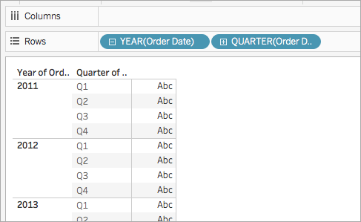

Slide 43
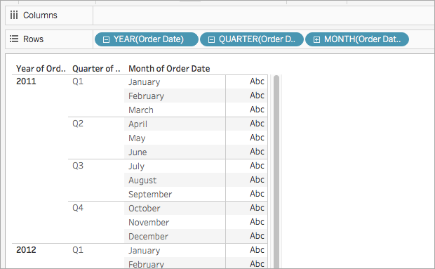
On the Rows shelf, click the plus icon (+) on the QUARTER(Order Date) field to drill down to MONTH(Order Date).

Slide 44
Select Analysis > Create Calculated Field.
In the calculation editor that opens, do the following:
Name the calculated field, Quarter Date.
Enter the following formula:
DATETRUNC('quarter', [Order Date])
DATETRUNC('quarter', [Order Date])
When finished, click OK.
The new date calculated field appears under Dimensions in the Data pane. Just like your other fields, you can use it in one or more visualizations.

Slide 45
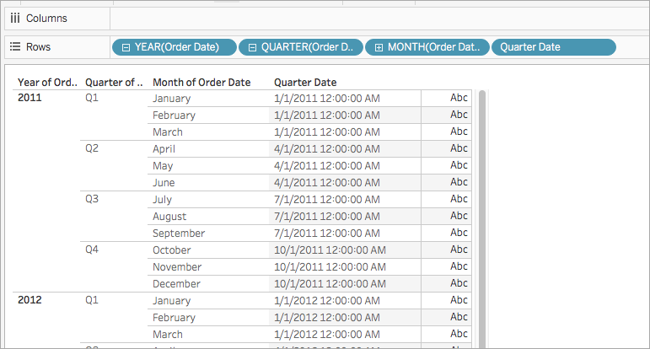
From the Data pane, under Dimensions, drag Quarter Date to the Rows shelf and place it to the right of MONTH(Order Date).
The visualization updates with year values. This is because Tableau rolls date data up to the highest level of detail.
On the Rows shelf, right-click YEAR(Quarter Date) and select Exact Date.
On the Rows shelf, right-click YEAR(Quarter Date) again and select Discrete.
The visualization updates with the exact quarter date for each row in the table.

Slide 46
Create Calculated Field in Tableau
In this article we will learn how to create calculated field in tableau worksheet to do further operations. For this first look into these two terms:
Tableau: Tableau is a very powerful data visualization tool that will be employed by data analysts, scientists, statisticians, etc. to see the info and obtain a transparent opinion supported the info analysis. Tableau is extremely famous because it can absorb data and produce the specified data visualization output during a very short time.
Field: A knowledge field may be a place where you’ll store data. Commonly wont to ask a column during a database or a field during a data entry form or web form. The sector may contain data to be entered also as data to be displayed.
Open the Tableau tool and connect a dataset into it. Drag and drop the one sheet of the connected dataset. Click on sheet1 to open the tableau worksheet. On clicking Sheet1 you will get whole dataset attributes on the left side and a worksheet for work.

Slide 47
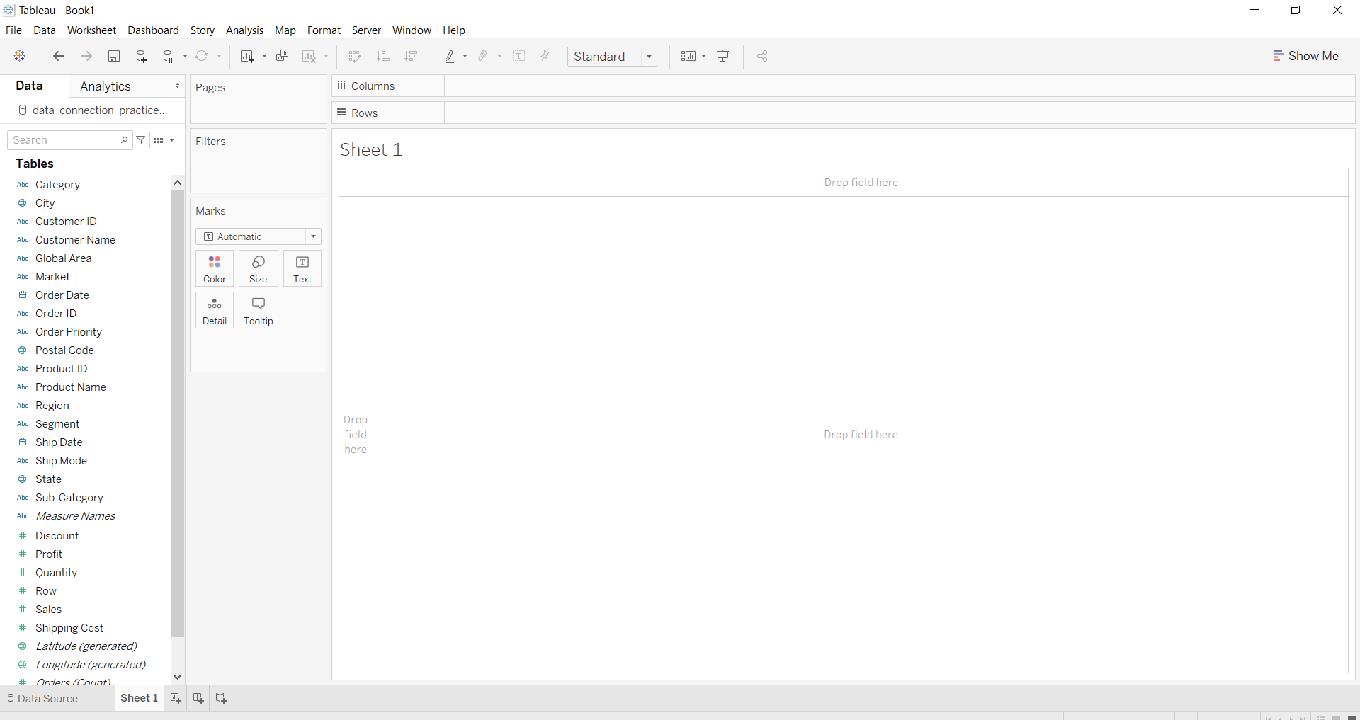

Slide 48
To create a calculated field you have to follow given instructions.
Go to Analysis or down arrow.
Click on create calculated field
Write the field name
Write the field formula for creation
Click Apply button.
You are done and see the data.

Slide 50
Step 1: Create the calculated field
In a worksheet in Tableau, select Analysis > Create Calculated Field.
In the Calculation Editor that opens, give the calculated field a name.
In this example, the calculated field is called Profit Ratio.
Step 2: Enter a formula
In the Calculation Editor, enter a formula.
This example uses the following formula:
SUM([Profit])/SUM([Sales])

Slide 52
Create a Dashboard in Tableau
In this article, we will learn how to create a dashboard in tableau. For this first look into two terms :
Tableau: Tableau is a very powerful data visualization tool that can be used by data analysts, scientists, statisticians, etc. to visualize the data and get a clear opinion based on the data analysis. Tableau is very famous as it can take in data and produce the required data visualization output in a very short time.
Dashboard: A dashboard could also a set of several views, letting you compare a selection of data simultaneously. For example, if you’ve got a group of views that you simply review a day, you’ll create a dashboard that displays all the views directly, instead of navigating to separate worksheets. Like worksheets, you access dashboards from tabs at the lowest of a workbook. Data in sheets and dashboards are connected; once you modify a sheet, any dashboards containing it change, and therefore the other way around. Both sheets and dashboards update with the newest available data from the info source.
Open the Tableau tool and connect a dataset into it. Drag and drop the one sheet of the connected dataset. Click on sheet1 to open the tableau worksheet. On clicking Sheet1 you will get whole dataset attributes on the left side and a worksheet for work.

Slide 54
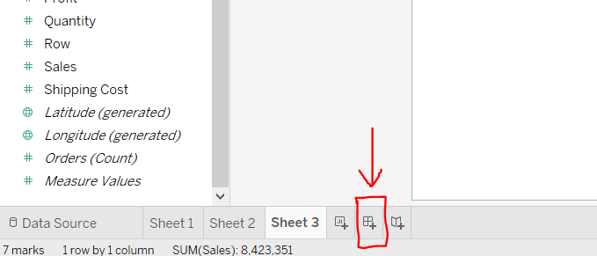
To create a dashboard you have to form at least one worksheet of any information with any features like crosstab, maps, charts, graphs, etc. For this you have to follow some steps :
Ready with the sheets and work for the dashboard.
Click on the square+ sign to open a new dashboard.

Slide 55
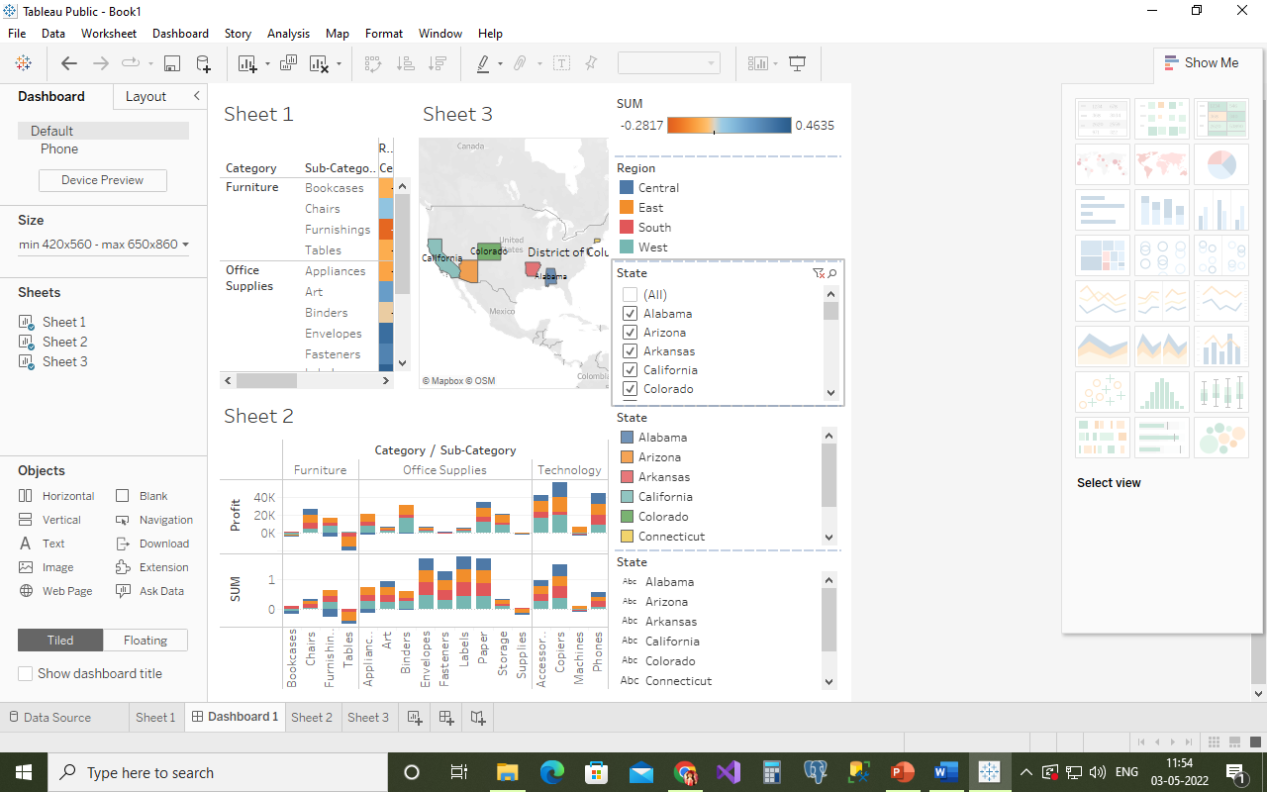
Drag and drop the sheets according to your choice.
Add some modifications (optional).
Example 1: In this example, we simply create a dashboard with only one sheet.

